Slide 1
PRESENTATION FOR INVESTORS
July, 2016
www.oaoktk.ru/en
Please scan the QR code
to download the presentation

Slide 2
I.
BUSINESS OVERVIEW
www.oaoktk.ru/en
2 / 28

Slide 3
THE COMPANY AT A GLANCE
One of the major coal suppliers in Western Siberia
Largest retail coal distribution network in Russia: 100 PoS
Since its establishment in 2000, the Company has launched four open-pit mines and two washing plants. All production assets including developed and extensive infrastructure, are located in the same 10-km-diameter industrial cluster
100% high-quality thermal coal grade D (under Russian classification)
Over 11 million tonnes of coal produced in 2015
Developed railroad network and facilities: handling capacity – 17 million tonnes per year, 90 km of railroad, six loading and one sorting station.
Structural capacity of two washing plants – 6 million tonnes per year
Modern and high-performance equipment fleet usage supporting efficient low-cost production – USD 11 per tonne of coal in 2015
Diversified sales capabilities balanced between domestic market (2014: 3.12 million tonnes) and export to Eastern Europe and Asia-Pacific region (2014: 7.20 million tonnes)
Employing over 4,400 people
KTK shares are quoted on MICEX (ticker: KBTK)
66.85% of share capital is owned by the management (Prokudin – 50.07%, Danilov – 16.78%), free float – 33.15% is distributed between more than 15 investment funds.
Coal production history, in millions of tonnes
 | 5 existing open-pits | 1 projected open-pits
Structural capacity | 17 million tonnes | 1.5-3 million tonnes
Coal reserves, JORC | 650 million tonnes | 68 million tonnes
Key operating and financial performance indicators
 | 2010 | 2011 | 2012 | 2013 | 2014 | 2015
Coal sales, in millions of tonnes | 8.54 | 10.66 | 10.20 | 10.60 | 10.32 | 10.69
including coal resale, in millions of tonnes | 2.16 | 2.08 | 1.70 | 1.78 | 0.98 | 1.20
Revenue, in millions of USD | 466 | 814 | 743 | 715 | 576 | 408
% change | 39% | 75% | (9%) | (4%) | (19%) | (29%)
EBITDA, in millions of USD | 70 | 133 | 112 | 77 | 65 | 44
% margin | 15.1 | 16.3 | 15.1 | 10.8 | 11.3 | 10.8
Net income, in millions of USD | 27 | 69 | 58 | 20 | <1 | 0.60
% margin | 5.8 | 8.4 | 7.8 | 2.8 | - | -
3 / 28

Slide 4
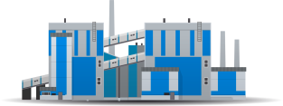
BUSINESS MODEL
Mining (open-pits)
Processing
Logistics
Markets
Proven and estimated resources
Extracted resources, %
Asia-Pacific
region
Coal washing
12
Vinogradovsky
119 million tonnes
To Meret station, Kemerovo region
Vostochny port, Nakhodka
CPT basis
South Korea
Kaskad 1
Capacity: 2 million tonnes
• power plants
• cement industry
Japan
• power plants
Taiwan
57
Karakansky South
19 million tonnes
Kaskad 2
Capacity:4,2million tonnes
• power plants
9
Cheremshansky
202 million tonnes
Eastern Europe
Coal sorting
To the border of Poland and Belarus
or Ukraine
DAF basis
Poland
• households
• public utilities
• industrial consumers
• power plants
Bryansky
243 million tonnes
0
Eight sorting and crashing units
To Meret station, Kemerovo region
FCA basis
Domestic market
2021
0
Listvenichny
67 million tonnes
Western Siberia
• households
• public utilities
• industrial consumers
To own retail
network
Raw coal
650
6,2
65%
proven and estimated
resources
incoming capacity
of washing plants per 1 year
share of
export sales
million tonnes
million tonnes
4 / 28

Slide 5
CHANGES SINCE IPO
Changes in business | 2009 | 2015 | Change
Coal production | 6.15 million tonnes | 11.00 million tonnes | 79%
Production capacity | 11 million tonnes | 17 million tonnes | 55%
Washing capacity | - | 6,2 million tonnes | -
Resources | 402 million tonnes | 660 million tonnes | 64%
Coal sales | 7.41 million tonnes | 10.69 million tonnes | 44%
Retail network | 61 PoS | 100 PoS | 64%
EBITDA | USD 69 million | USD 44 million | -36%
Market capitalization | USD 640 million | USD 80 million | -87%
5 / 28

Slide 6
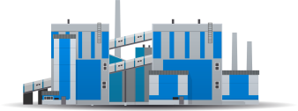
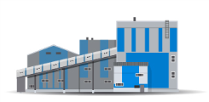
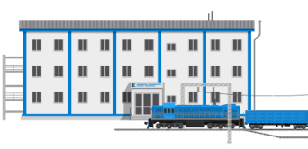
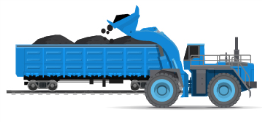
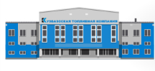
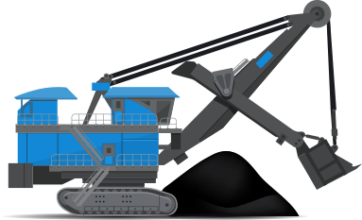
INDUSTRIAL CLUSTER
Rail scheme
Coal-loading stations
Transit stations
Coal-collecting station
Russian Railroads’ rail
КТК’s rail
KRU’s rail
Industrial cluster
USD 150
million
Kaskad 2 washing plant
Cost to launch an open-pit mine with a capacity of 3-5 million tonnes per year
from the greenfield stage
Vinogradovsky
Cheremshansky
Vinogradovskaya
Kaskad
Coal-collecting
station
Coal-loading
station
45-50 km
From the coal-loading to the coal-collecting station
USD 60-100 million
Cost to launch an open-pit mine with a capacity of 3-5 million tonnes per year with existing infrastructure
Listvenichny
Kaskad 1 washing plant
Fadeevsky
Vinogradovskaya
Kaskad
Pesterevo
Operations center
Karakansky South
Bryansky
USD 20 million
Uba
Karakansky South
6.1 km
Meret
Karakansky South
Start of coal production
4,900 km
Eastern Europe
6,100 km
Asia-Pacific region
Diameter of industrial cluster: 10 km
16.7
Existing capacity of railroad infrastructure
million tonnes 11,3 million tonnes transported in 2015
Investment into mining equipment per each 1 million tonnes of coal production capacity
7 / 29

Slide 7
DIVIDEND HISTORY
 |  |  |  |  |  |  | % of net profit
 | Period | Dividend paid, in thousands of RUB | Dividend per share, RUB | Dividend yield | Stock quote, RUB | Date of approvement | IFRS | RAS
2015 | 1Q | 248 ,146 | 2,5 |  | 86.80 | 30.06.2015 | 96,2%
 | The Company's new dividend policy was approved by the Board of Directors on March 16, 2015. Under the new policy, the company plans to pay out more than 25% of net profit under IFRS as dividend.
2014 | FY | No dividend payments |  |  | 92.30 | 15.04.2015
 | The Company's new dividend policy was approved by the Board of Directors on March 16, 2015. Under the new policy, the company plans to pay out more than 25% of net profit under IFRS as dividend.
2013 | FY | 496,292 | 5.00 | 7.2% | 69.90 | 18.04.2014 | 77.5% | 96.2%
2012 | FY | 496,292 | 5.00 | 7.5% | 67.00 | 15.04.2013 | 27.4% | 27.7%
2011 | FY | 595,550 | 6.00 | 3.4% | 175.33 | 14.03.2012 | 29.5% | 28.9%
2010 | FY | 297,775 | 3.00 | 1.4% | 221.33 | 23.06.2011 | 36.2% | 55.9%
 | The Company's dividend policy was approved by the Board of Directors on November 3, 2009.
8 / 29

Slide 8
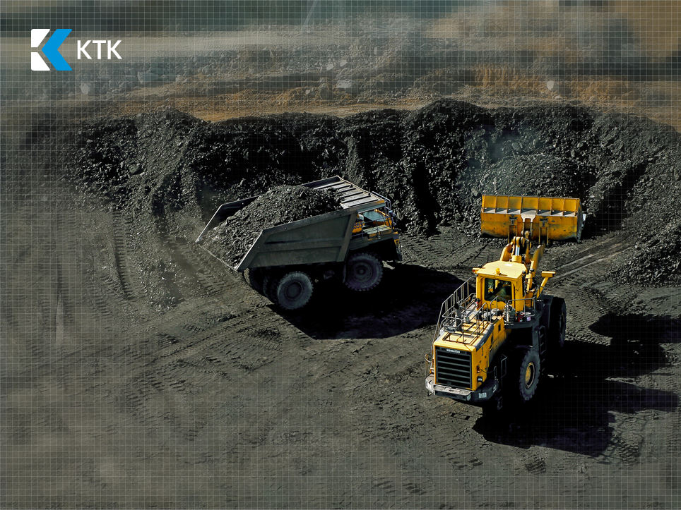
II.
OPERATIONAL
HIGHLIGHTS
www.oaoktk.ru/en
9 / 29

Slide 9
KEY OPERATIONAL HIGHLIGHTS
Operational results for 2015
Coal production | 11.00 million tonnes | 4% Y-o-Y
Coal processing | 8.32 | -4% Y-o-Y
Stripping volume | 59.02 million cbm | -1% Y-o-Y
Volume of blasted rock mass | 35.45 million cbm | -
Average stripping ratio | 5.40 | -5% Y-o-Y
Sales | 10.69 million tonnes | 4% Y-o-Y
Export sales | 6.9 million tonnes | -4% Y-o-Y
Domestic sales | 3.78 million tonnes | 21 % Y-o-Y
Average sales price | USD 21.80 per 1 tonne | -27.2% Y-o-Y
Mining operations, in millions of cbm
Coal processing, in millions of tonnes
10 / 29

Slide 10
COAL PRODUCTION AND SALES
Production in Russia, in millions of tonnes
KTK’s sales in 2015, in millions of tonnes
10.69
million tonnes
Domestic sales, in millions of tonnes
Export sales, in millions of tonnes
10.69
million tonnes
11 / 29
Source: KTK’s research, Ministry of Energy of Russian Federation

Slide 11
AVERAGE SELLING PRICES AND MARKETS
Key markets
Sales, in millions of tonnes
KTK industrial cluster (mining)
Poland
Nakhodka,
Vostochny port
millions of tonnes
S. Korea
Japan
Япония
Average selling price, RUB per tonne
Taiwan
(48%)
1.7
Europe
3.78
Domestic
market
Russia
5.21
Asia-Pacific
region
South Korea
Japan, Taiwan
Types of end consumers
12 / 29
Households
Public
utilities
Industrial
consumers
Energy plants
Cement producers

Slide 12
III.
FINANCIAL PERFORMANCE
www.oaoktk.ru/en
13 / 29

Slide 13
KEY FINANCIAL HIGHLIGHTS
2015 financial results
Revenue | USD 410 million | (28%) Y-o-Y
EBITDA | USD 44 million | (32%) Y-o-Y
EBITDA margin | 10.8% | (4.4 ppts) Y-o-Y
Net income | USD 0.607 million | 237% Y-o-Y
Operating cash flow | USD 38 million | 65%Y-o-Y
CAPEX | USD 15 million | (44%) Y-o-Y
Net debt | USD 77million | (29%) Y-o-Y
Net debt/EBITDA | 1.76⁽¹⁾ | 6 ppts Y-o-Y
Cash and cash equivalents | USD 47 million | (64%) Y-o-Y
Revenue and EBITDA, in millions of USD
Operating cash flow and CAPEX, in millions of USD
14 / 29
(1) 2.09 if calculated in RUB

Slide 14
SEGMENT REPORTING
2015 Segment results
Growth of gross profit from export sales, decrease in other business segments
Volumes of resale of coal is decreasing
Gross profit margin in sales segment of own coal in the domestic market decreased from the level of 2014 and grew in all other business segments
Gross profit by segment, in millions of USD
(22%)
Revenue and cost of sales by segment, in millions of USD
(28%)
(30%)
Gross profit margin by segment
15 / 29

Slide 15
COST OF SALES AND PRODUCTION CASH COSTS
Cost of sales breakdown and dynamics, in millions of USD
Production cash costs dynamics
Production cash costs breakdown, in millions of USD
16 / 29

Slide 16
SETTLEMENT OF FINANCIAL LIABILITIES
Indebtedness as of 31.12.15
Net debt | USD 77 million | (29%) Y-o-Y
Net debt to EBITDA | 1.76⁽¹⁾ | 6 ppts Y-o-Y
Average interest on RUB loans | 9.25%⁽²⁾ | (0,4)ppts Y-o-Y
Average interest on USD loans | 4.13% | (5 ppts) Y-o-Y
Committed credit lines | USD 564 million |  | 188% Y-o-Y
Credit portfolio diversification | 11 banks from Russia and Europe
Net Debt to EBITDA, in millions of USD
Loan portfolio structure
⁽¹⁾
Total debt:
USD 124 million
Total debt:
USD 124 million
(1) 2.09 in 2015, if calculated in RUB
(2) Including subsidy of Belarus Republic for purchasing Belaz mining trucks
17 / 29

Slide 17
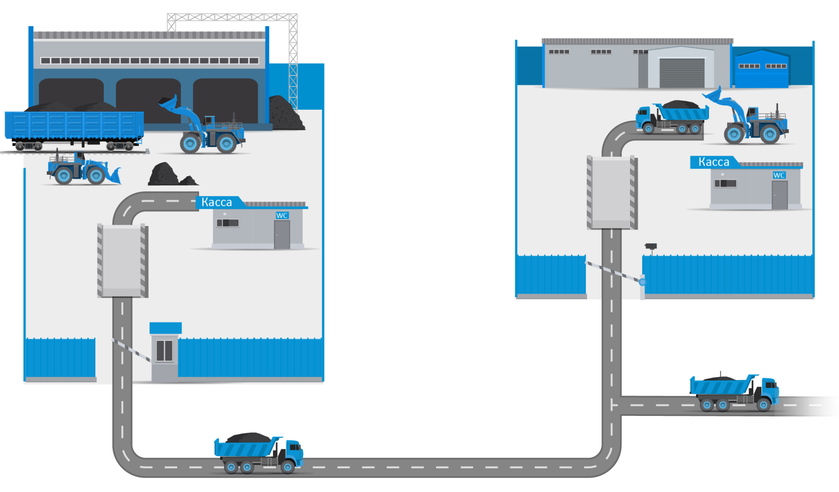
WAREHOUSES-SHOPS INVESTMENT PROJECT
Warehouse terminal
Warehouse-shop
Coal sorting
Documents for social compensations
Cash payments
Cash
payments
Weighting
Pre-packing
Video monitoring
Weighing
Security
Storage
x 3
Coal transportation from warehouse-shop to end consumer
Delivery
cash collector security guard loader
operator
Coal transportation from warehouse terminal to warehouse-shop
18 / 29

Slide 18
IV.
STRATEGY
www.oaoktk.ru/en
19 / 29

Slide 19
PRODUCTION AND LOGISTICS
STRATEGIC LONG-TERM OBJECTIVES I
Expanding the resource base
Resource base expansion Vinogradovsky tenement’s design capacity has been increased to 5 million tonnes per year.
In 2014 KTK obtained a license to the Listvennichny tenement, with reserves in the amount of 56 million tonnes. It is located in the center of KTK’s production cluster.
Coal production in the Bryansky open-pit mine started in 2015. Mining equipment and mining workers from Karakansky South will provide for the production.
Increasing thermal coal production
Total production capacity of existing open-pit mines is 13 million tonnes. Annual coal production can be easily increased to this level, but only following the increase of the coal prices at the Asia-Pacific region.
Developing coal transport infrastructure
Since Kuzbass Transport Company LLC spinoff, KTK is not planning to establish own railcar fleet in the medium-term perspective.
The existing capacity of Meret sorting station is 17 million tonnes per year and that’s enough to satisfy growing production requirements. Currently only 80% of this capacity is being used.
KTK’s management is expecting a coal handling rate reduction at the ports of the Asia-Pacific export direction.
Applying innovative technologies
Company is developing a project to include coal-drying unit to the project of the third washing plant.
3D mining planning is already used by KTK’s engineers.
These directions of investments are on hold until coal prices in Asia-Pacific region will start to recover.
20 / 29
Notes:
Содержание слайда: Список основных направлений инвестиций до 2016 года (Строительство ОФ, Расширение парка горной техники, Развитие ЖД инфраструктуры, Развитие региональной сети, Брянский разрез, Прочая инфраструктура); Планы по приобретению горной техники до 2016 года.
Инвестиционная программа КТК ориентирована на строительство обогатительных мощностей для увеличения объёмов производства угля экспортного качества. На строительство ОФ в 2012-2016 годах планируется направить 47% инвестиций. Общий объём которых инвестиций составляет 521 млн. долларов.
Инвестиционная программа в 2012 году выполняется в полном объёме, в четвёртом квартале планируется ввод ОФ Каскад-2.
Не менее важными направлениями инвестиций является расширение парка горнодобывающей техники, инвестиции в развитие ЖД инфраструктуры и розничной сети Компании.
В случае неблагоприятного развития ситуации с ценами на экспортных рынках, реализация крупных проектов в рамках утверждённой инвестиционной программы будет сдвигаться на более поздние периоды.
До 2015 года предусмотрены инвестиции в геологоразведочные работы на перспективном участке Брянский.

Slide 20
NEW PRODUCTS AND SALES DEVELOPMENT
STRATEGIC LONG-TERM OBJECTIVES II
Improving the quality of coal products
The Company is planning to implement selective mining at all the open-pits to get more coal for sorting.
Technical upgrading of Washing Plant «Kaskad-2» has resulted in increase of washing capacity to 3.6 mln tons.
Company’s modernization plan implies production capacity growth of Washing Plant «Kaskad-1» from 1 to 3 mln. tons by 3rd quarter, 2016. Investment in this project will be made only under the condition of rising prices on international markets.
Development of fundamentally new products
The Company expands its product line by increasing the production of sorted marks of coal and pre-packed coal.
The Company continues an experiment with producing coal briquettes.
Domestic market development
KTK’s own retail network in Russia has 100 point of sale, of which 30 are innovative warehouse-shops.
KTK’s own wholesale network in Poland has 15 warehouse terminals. The management is planning to open new warehouses in future period.
These directions of investments are on hold until coal prices in Asia-Pacific region will start to recover.
21 / 29
Notes:
Содержание слайда: Список основных направлений инвестиций до 2016 года (Строительство ОФ, Расширение парка горной техники, Развитие ЖД инфраструктуры, Развитие региональной сети, Брянский разрез, Прочая инфраструктура); Планы по приобретению горной техники до 2016 года.
Инвестиционная программа КТК ориентирована на строительство обогатительных мощностей для увеличения объёмов производства угля экспортного качества. На строительство ОФ в 2012-2016 годах планируется направить 47% инвестиций. Общий объём которых инвестиций составляет 521 млн. долларов.
Инвестиционная программа в 2012 году выполняется в полном объёме, в четвёртом квартале планируется ввод ОФ Каскад-2.
Не менее важными направлениями инвестиций является расширение парка горнодобывающей техники, инвестиции в развитие ЖД инфраструктуры и розничной сети Компании.
В случае неблагоприятного развития ситуации с ценами на экспортных рынках, реализация крупных проектов в рамках утверждённой инвестиционной программы будет сдвигаться на более поздние периоды.
До 2015 года предусмотрены инвестиции в геологоразведочные работы на перспективном участке Брянский.

Slide 21
FINANCE AND MANAGEMENT
STRATEGIC LONG-TERM OBJECTIVES III
Efficient loan portfolio management
In April 2015 KTK Overseas AG trading house was established. Its functions will include working with traders and attracting trade financing for export shipments.
The Company’s loan portfolio management policy is conservative. The management is always searching for new possibilities to refinance existing loans to decrease interest rates and increase average loan maturity.
Improving corporate governance
KTK’s controlling shareholder is focused on the high quality of corporate governance and an open discussion with minority shareholders.
Alex Williams, Independent board member, is representing Investor Protection Association.
The IR office in Moscow is always ready to communicate with analysts and investors.
The company organizes meetings with management and visits to production assets for analysts, investors and media.
Optimizing costs and increasing efficiency
KTK executed a cost-cutting program in 2012-2015. All the incoming recourses and services were revised to lower the prices.
Responsibility
KTK has undergone inspection procedures regarding compliance with ISO Standards 9001:2008 and ISO 14001:2004 and certification audit of OHSAS Standard 18001:2007. Certification under Management System by OHSAS Standard 18001:2007 describes basic possibilities and competences of the personnel and technology processes regarding operational safety of Kuzbasskaya Toplivnaya Company. Receipt of the certificate under such Standard confirms the fact that КТК enterprises attach high priority to operational safety and all processes of enterprises in this system are in line with the world standards.
22/ 29
Notes:
Содержание слайда: Список основных направлений инвестиций до 2016 года (Строительство ОФ, Расширение парка горной техники, Развитие ЖД инфраструктуры, Развитие региональной сети, Брянский разрез, Прочая инфраструктура); Планы по приобретению горной техники до 2016 года.
Инвестиционная программа КТК ориентирована на строительство обогатительных мощностей для увеличения объёмов производства угля экспортного качества. На строительство ОФ в 2012-2016 годах планируется направить 47% инвестиций. Общий объём которых инвестиций составляет 521 млн. долларов.
Инвестиционная программа в 2012 году выполняется в полном объёме, в четвёртом квартале планируется ввод ОФ Каскад-2.
Не менее важными направлениями инвестиций является расширение парка горнодобывающей техники, инвестиции в развитие ЖД инфраструктуры и розничной сети Компании.
В случае неблагоприятного развития ситуации с ценами на экспортных рынках, реализация крупных проектов в рамках утверждённой инвестиционной программы будет сдвигаться на более поздние периоды.
До 2015 года предусмотрены инвестиции в геологоразведочные работы на перспективном участке Брянский.

Slide 22
V.
ENVIRONMENT
www.oaoktk.ru/en
23 / 29

Slide 23
KARAKANSKY WILDLIFE SANCTUARY
Public wildlife sanctuary of Kemerovo region Karakansky ridge
44
rare species of insects (orthoptera, butterflies, spiders)
In 2012 КТК passed environmental audit, initiated by the European Bank for Reconstruction and Development
12
species of protected rare plants
468 m
maximum altitude
above sea level
5
endangered species of birds
Monitoring polygon
(size 0,5 ha.): Survey of key ecological indicators
forest-steppe marmots
colony
eared bat
Underground lake, source of drinking water for a small village nearby
300-459 m
450-850 m
length of the southwest slope
length of the northeast slope
1115.2
size of wildlife sanctuary
531
rare
plants
15
scientists from Novosibirsk and Tomsk, summer 2013
ha.
species
expeditions
24 / 29
Notes:
Содержание слайда: Список основных направлений инвестиций до 2016 года (Строительство ОФ, Расширение парка горной техники, Развитие ЖД инфраструктуры, Развитие региональной сети, Брянский разрез, Прочая инфраструктура); Планы по приобретению горной техники до 2016 года.
Инвестиционная программа КТК ориентирована на строительство обогатительных мощностей для увеличения объёмов производства угля экспортного качества. На строительство ОФ в 2012-2016 годах планируется направить 47% инвестиций. Общий объём которых инвестиций составляет 521 млн. долларов.
Инвестиционная программа в 2012 году выполняется в полном объёме, в четвёртом квартале планируется ввод ОФ Каскад-2.
Не менее важными направлениями инвестиций является расширение парка горнодобывающей техники, инвестиции в развитие ЖД инфраструктуры и розничной сети Компании.
В случае неблагоприятного развития ситуации с ценами на экспортных рынках, реализация крупных проектов в рамках утверждённой инвестиционной программы будет сдвигаться на более поздние периоды.
До 2015 года предусмотрены инвестиции в геологоразведочные работы на перспективном участке Брянский.

Slide 24
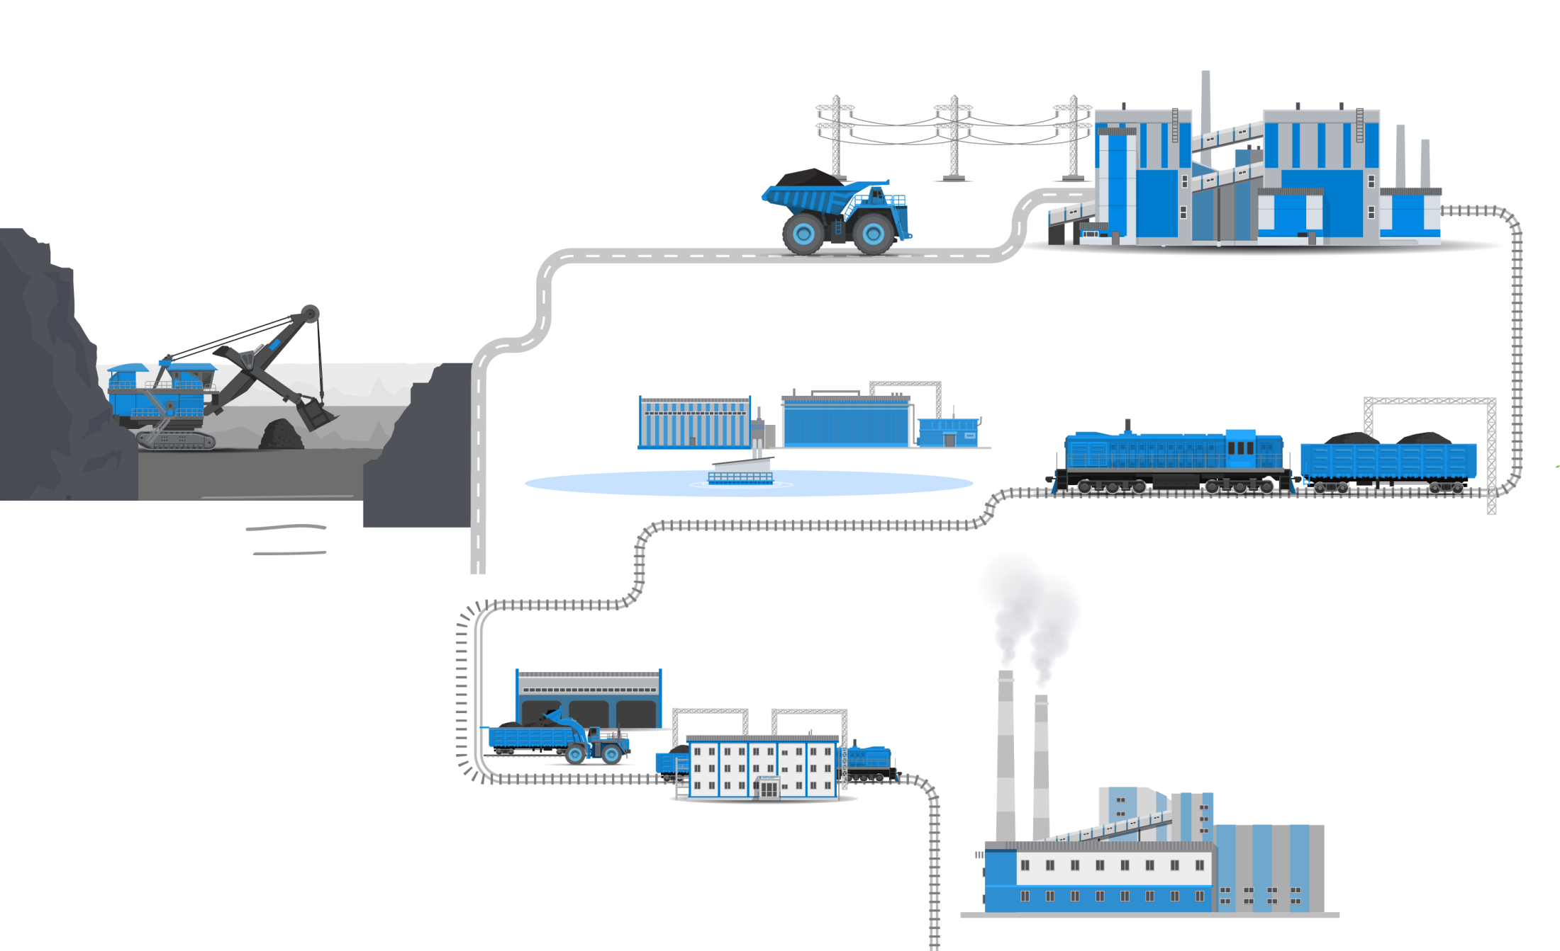
ENVIRONMENTALLY RESPONSIBLE PRODUCTION
In 2015 to produce breakstone the Company launched a crushing and screening complex with dedusting system
New energy transition line with increased thickness of the cable was built in 2013 to reduce electricity losses
Dedusting systems at Kaskad 1 and Kaskad 2 washing plants do not allow any emissions of coal dust
Regular watering of technical roads to reduce coal dust in the atmosphere
40 out of 216 units
of KTK’s mining equipment run on electricity, reducing the volume of used fuel
Tires, scrap-metal and waste engine oil are used for recycling
Closed cycle of water used at Kaskad 2 washing plant is supplied with technical water by Vinogradovsky open-pit mine
Internal dumps are formed on the open-pit mines to reduce land disturbance
Waste water treatment plant at industrial cluster produce water suitable for drinking.
New waste water treatment plan is planned at Vinogradovsky open-pit mine
↓ 10-12% less
(250,000-300,000 tonnes per year)
transportation volumes by coal washing
↓ 40 km less
distance of auto-transportation client due to the new warehouse terminal at coal-collecting station with 1.5 million tonnes of storage capacity saves 5,000 liters of fuel every year
↓ 12% less
emissions to the atmosphere by burning washed coal
Energy Coal dust Emissions to atmosphere Fuel saving
25 / 29
Water Transportation
Recycling
Dumps
Notes:
Содержание слайда: Список основных направлений инвестиций до 2016 года (Строительство ОФ, Расширение парка горной техники, Развитие ЖД инфраструктуры, Развитие региональной сети, Брянский разрез, Прочая инфраструктура); Планы по приобретению горной техники до 2016 года.
Инвестиционная программа КТК ориентирована на строительство обогатительных мощностей для увеличения объёмов производства угля экспортного качества. На строительство ОФ в 2012-2016 годах планируется направить 47% инвестиций. Общий объём которых инвестиций составляет 521 млн. долларов.
Инвестиционная программа в 2012 году выполняется в полном объёме, в четвёртом квартале планируется ввод ОФ Каскад-2.
Не менее важными направлениями инвестиций является расширение парка горнодобывающей техники, инвестиции в развитие ЖД инфраструктуры и розничной сети Компании.
В случае неблагоприятного развития ситуации с ценами на экспортных рынках, реализация крупных проектов в рамках утверждённой инвестиционной программы будет сдвигаться на более поздние периоды.
До 2015 года предусмотрены инвестиции в геологоразведочные работы на перспективном участке Брянский.

Slide 25
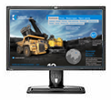
CONTACTS
Kuzbasskaya Toplivnaya Company PJSC (KTK)
MICEX: KBTK
www.oaoktk.ru/en
Head office in Kemerovo:
4, 50 let Oktyabrya street, Kemerovo, 650991, Russia
Representative office in Moscow: 29, Serebryanicheskaya naberezhnaya, Moscow, 109028, Russia
Investor calendar: www.oaoktk.ru/en/investors
To subscribe for news please request: es@oaoktk.ru
News and announcements (Russian only)
www.facebook.com/oaoktk
Presentations
www.slideshare.net/oaoktk
Video
www.youtube.com/oaoktkru
Elena Sarycheva
Head of public affairs department
+7 (3842) 36-47-62
es@oaoktk.ru
Information about the Company
Press releases
Stock quotes
Presentations
Financial reports under IFRS
Investor calendar
Visit our website:
www.oaoktk.ru/en
26 / 29

Slide 26
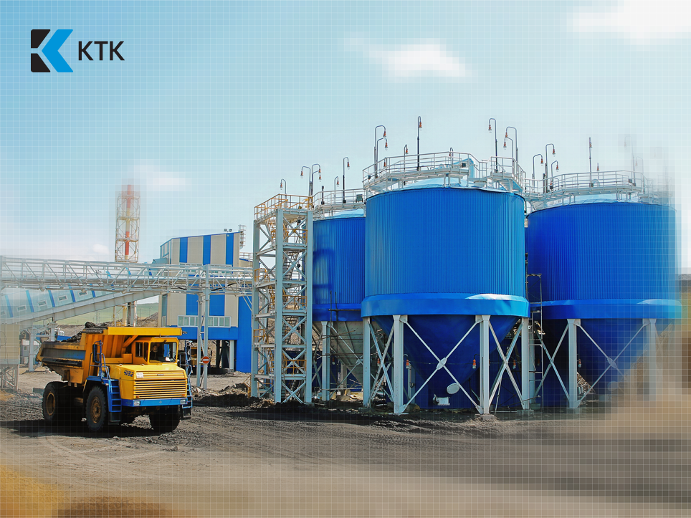
APPENDICES
www.oaoktk.ru/en
27 / 29

Slide 27
Kuzbasskaya Toplivnaya Company PJSC
CORPORATE STRUCTURE
Production
Transportation, energy and real estate
100%
Sales
Industrial cluster
Vinogradovsky open-pit
Domestic market Wholesale and retail
Export
100%
КТК Polska Sp. z.o.o.
Wholesale sales in Poland
Open-pit mine
Karakansky South
Railroad logistics
Freight Forwarding Company Meret LLC
100%
Kemerovo Region
Kuzbasstoplivosbyt PJSC
Open-pit mine
Vinogradovsky
51%
Novosibirsk Region Novosibirsk Fuel Corporation LLC
100%
КТК Overseas AG
Trade house in for export operations of the Group
Open-pit mine
Cheremshansky
Energy and heat producer
Kaskad-Energo PJSC
Open-pit mine
Bryansky
51%
Altay region
Altay Fuel Company PJSC
Land and real estate management
Kaskad-Geo LLC
License
Listvenichny
100%
KTK’s share
Omsk region
Transugol LLC
28 / 29

Slide 28
MINING EQUIPMENT
Toyota
Land Cruiser
107
1.95 m
31
12
5
20
6
4
2
м
Mining trucks
Loaders
Locomotives
Graders
Dozers
30
Statue of Liberty
(excl. base)
43 m
20
5
19
8
10
4
5
м
Draglines
Sorting and crushing units
Drill Rigs
Shovels
Rope
shovels
216
46
units of
mining
equipment
units of
support transport
Electric mining equipment reduces production costs and environmental damage
29 / 29

